Slide 1
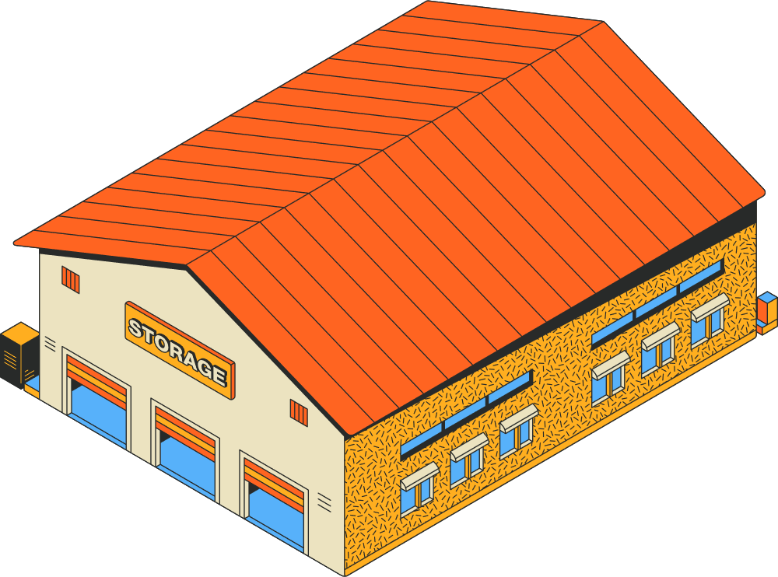




SCHOOL DISTRICTS
Property Deductible Provisions
STORAGE SHED
$100,000 Limit of Insurance
HIGH SCHOOL
$150 Million Limit of Insurance
Minimum Wind & Hail Deductible
Wind & Hail Deductible Provision
$1,500,000
$200,000 or 1%
(whichever is greater)
$200,000 or 1%
(whichever is greater)
Any wind & hail loss to this building would be under the minimum deductible provision and essentially self insured for these two perils.
Wind & Hail Deductible Provision
$4,500,000
$250,000 or 3%
(whichever is greater)
*Please note that there is a $50,000 property deductible for all other covered perils.
*Please note that there is a $50,000 property deductible for all other covered perils.

Slide 2
COVERAGE CLARITY
Occurrence versus Aggregate
WEST BEND
AUTO OWNERS
General Liability: $1,000,000 Occurrence / $2,000,000 Aggregate
General Liability: $2,000,000 Occurrence / $4,000,000 Aggregate
Umbrella: $10,000,000 Occurrence / $10,000,000 Aggregate
Umbrella: $9,000,000 Occurrence / $9,000,000 Aggregate
Occurrence Claim Example
Aggregate Claim Example
A business experiences a $11 million liability claim
A business experiences two liability claims, each $6.5 million
1 Claim: $1M General Liability + $5.5M Umbrella = $6.5 Million
2 Claim: $1M General Liability + $4.5M Umbrella = $5.5 Million
WEST
BEND
$1M General Liability + $10M Umbrella = $11 Million
FULL Claim is Covered
WEST
BEND
st
nd
Remaining
$1M Uncovered
1 Claim: $2M General Liability + $4.5M Umbrella = $6.5 Million
2 Claim: $2M General Liability + $4.5M Umbrella = $6.5 Million
AUTO
OWNERS
$2M General Liability + $9M Umbrella = $11 Million
FULL Claim is Covered
AUTO
OWNERS
st
nd
FULL Claim is Covered

