Slide 1
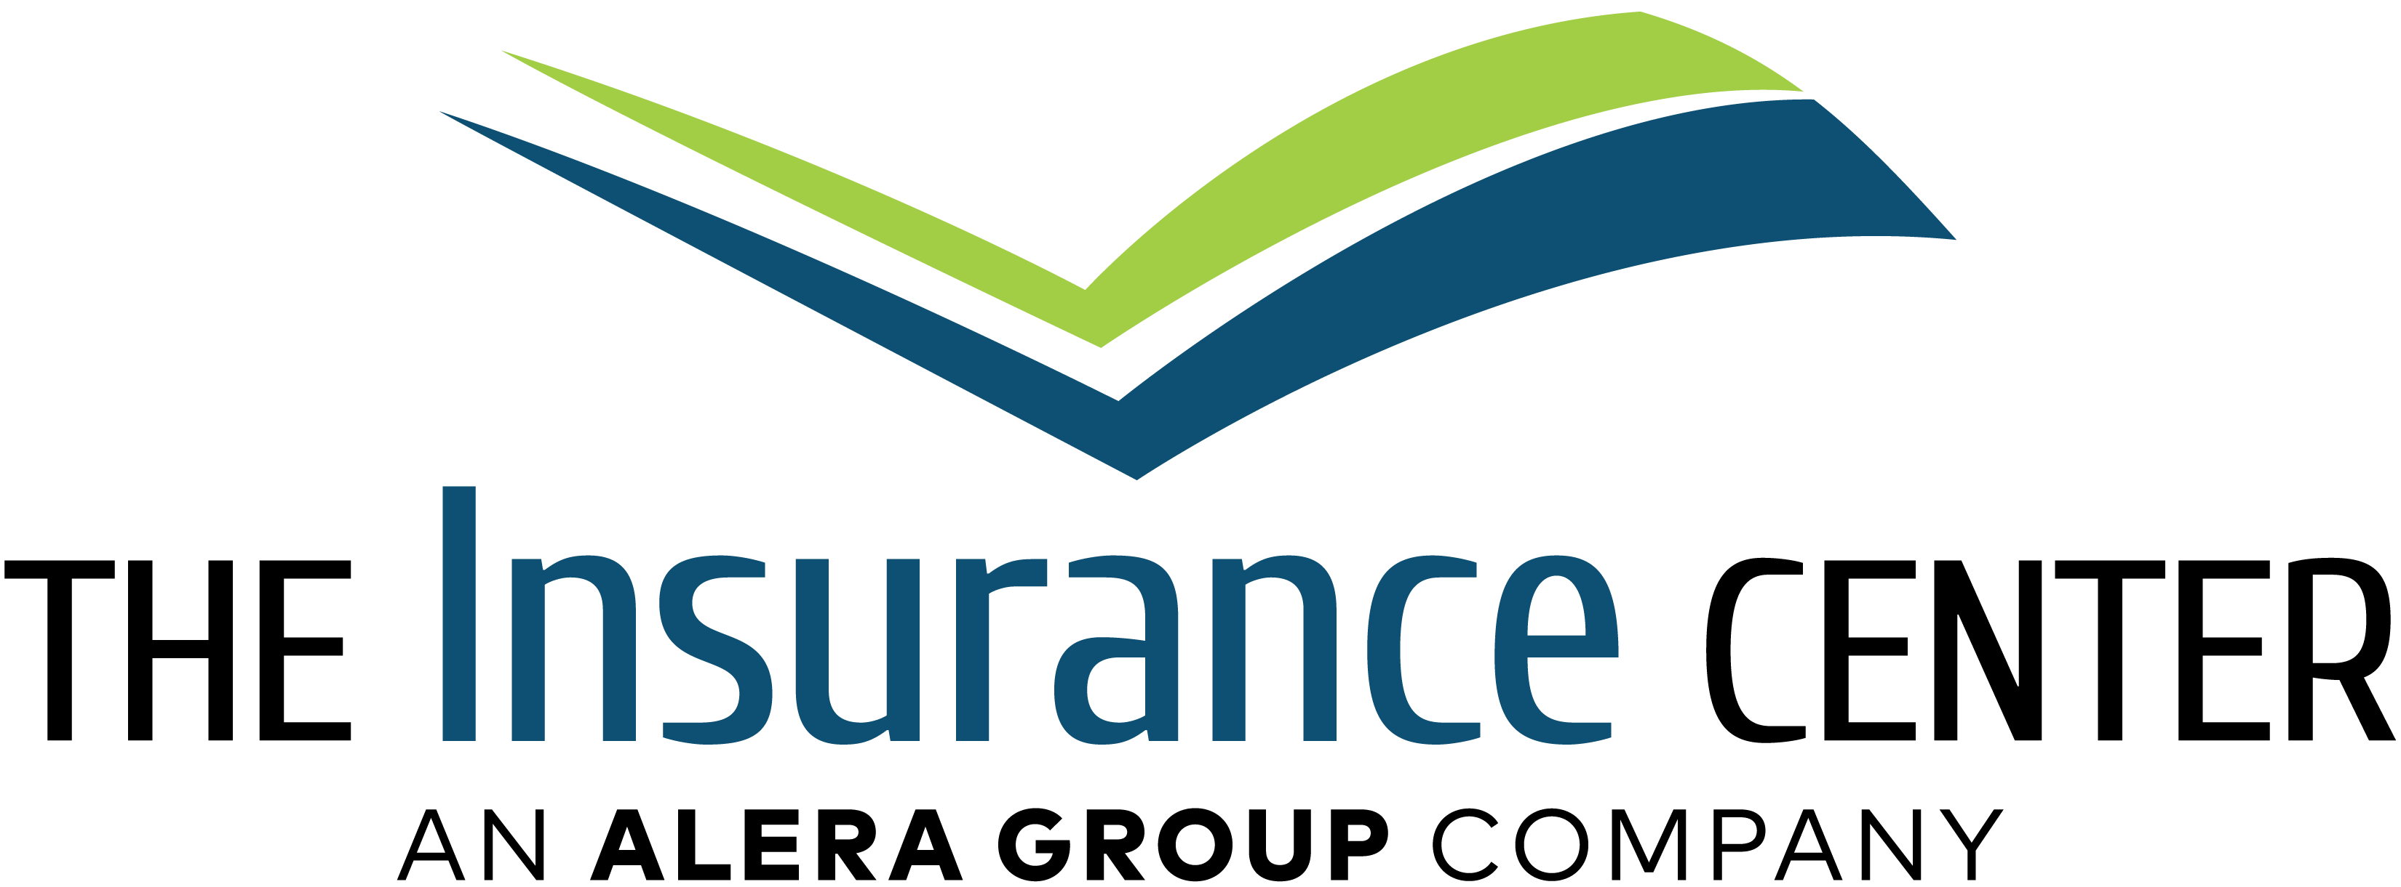

Ron Burgundy Manufacturing
Playbook
August 25, 2025
Prepared by: Sensei Coole

Slide 2
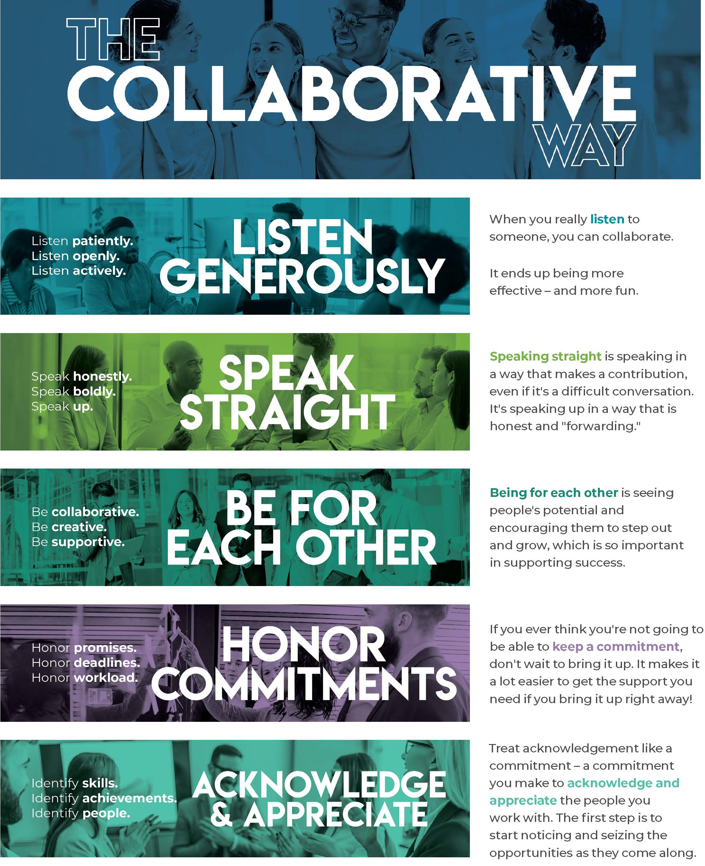
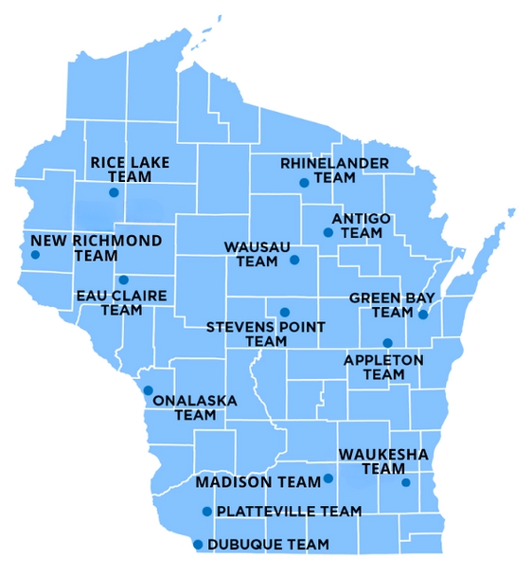
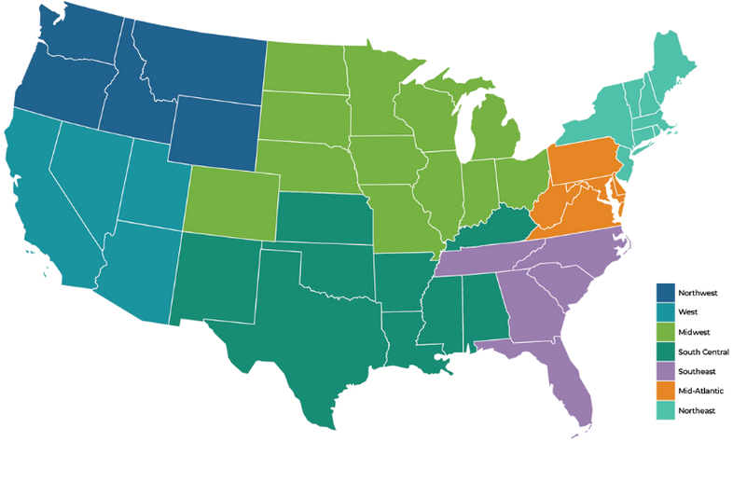
Local Presence, National Reach.
Influence – 14th largest insurance broker in the U.S.
Depth – 4,600+ entrepreneurial risk and insurance professionals
Leverage – $7 billion in buying power with insurance markets
Breadth – National footprint composed of 180+ locations
Strength – $1.5 billion in gross revenue**

Slide 3

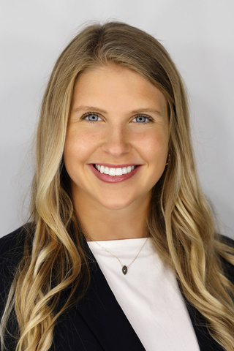
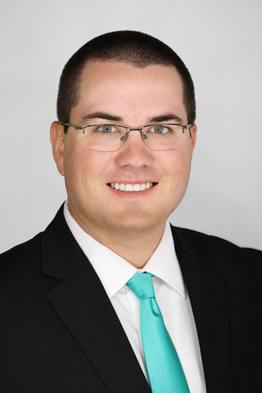
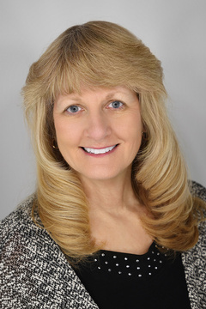
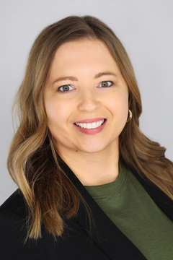
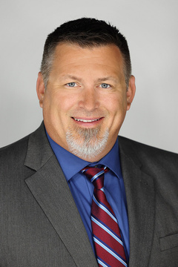
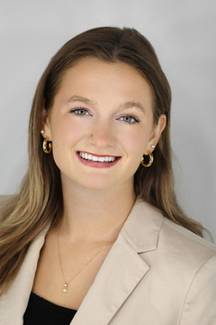
Meet the Team
Sam Bryngelson
George Weidert
Business Insurance Specialist
(920) 278-5050
samantha.bryngelson@aleragroup.com
Customer Service - Agent
(608) 740-3896
george.weidert@aleragroup.com
Sam helps transfer your risk with a tailored insurance policy and improves all aspects of your risk profile.
George provides exceptional service and supports your day-to-day service needs.
Barbara Conway
Deanna Lutz
Jason Trader
Lydia Malecek
Commercial Product & Marketing Specialist
(608) 470-4329
barbara.conway@aleragroup.com
Claims Specialist
(920) 383-8205
deanna.lutz@aleragroup.com
Risk Management Specialist
(920) 383-8177
jason.trader@aleragroup.com
Client Resource Coordinator
(608) 791-3160
lydia.malecek@aleragroup.com
Barbara focuses on placing your risk with the most suitable carriers to fit your needs.
Deanna facilitates your claims and provides advocacy on your behalf.
Jason helps you drive a culture of safety and compliance throughout your workplace.
Lydia delivers in-house and carrier resources to help improve your business beyond the policy.

Slide 4


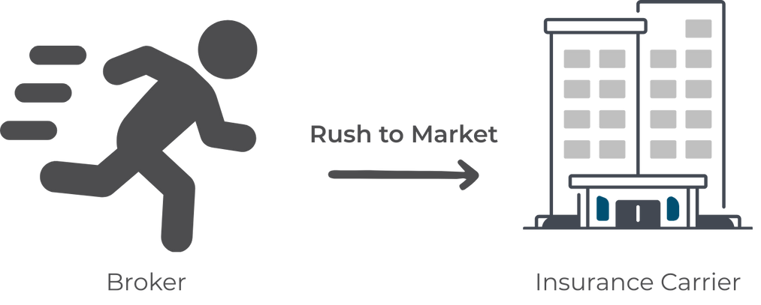
Broker Selection vs Bidding
Part 1
Time & Efficiency
  More brokers = more duplicated work (underwriting questions, supplements, LC visits, proposals, follow ups, etc.)
  Increased quoting efforts by brokers & carriers = higher sales pressure
Insurance Market Access
  Carriers assign brokers on a first-come, first-served basis
  Incumbents often block markets; new brokers rush to compete
  Risk: Strong markets go to weak brokers, resulting in “rolling” and other subpar outcomes

Slide 5
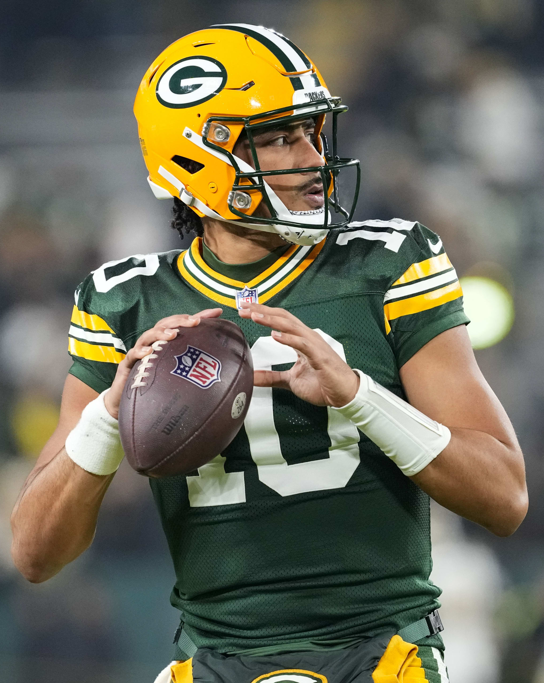

Broker Selection vs Bidding
Part 2
Underwriter Engagement
  Underwriters manage 50–150 files at once
  Submissions from non-controlling brokers = <10% win rate
  Key question: “Do you control the account?”
    Yes = prioritized, better pricing, stronger terms
    No = deprioritized
Leverage & Control
  Top brokers negotiate directly with top carriers on your behalf
  They protect your brand, highlight strengths, and drive value
  True broker partners give you more control, better outcomes
Hire the best agent on the front end.

Slide 6
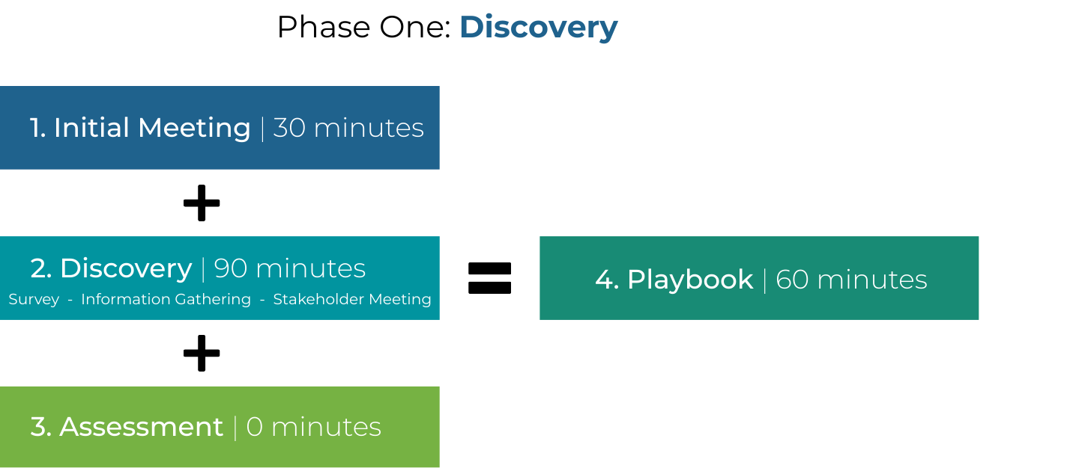
Playbook Approach
Transform risk into a competitive advantage
Objective: Best in class risk profile
  — Optimal spend and coverage terms — Safe and secure work environment — Sustainable competitive edge

Slide 7

The Playbook Advantage
Maximize ROI on insurance spend through a modern approach
Create internal alignment around risk appetite, risk transfer, and risk management
Identify coverage gaps and opportunities
Manage the cost of risk with 40+ financial levers
Position as a leader in managing risk over transactional purchasing
6

Slide 8
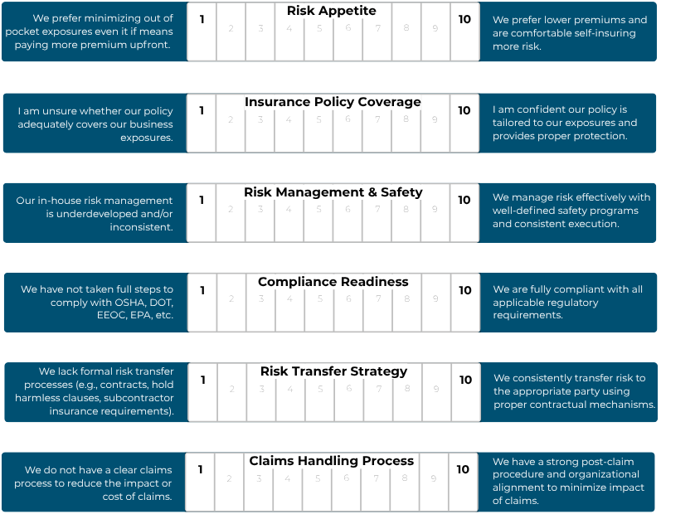
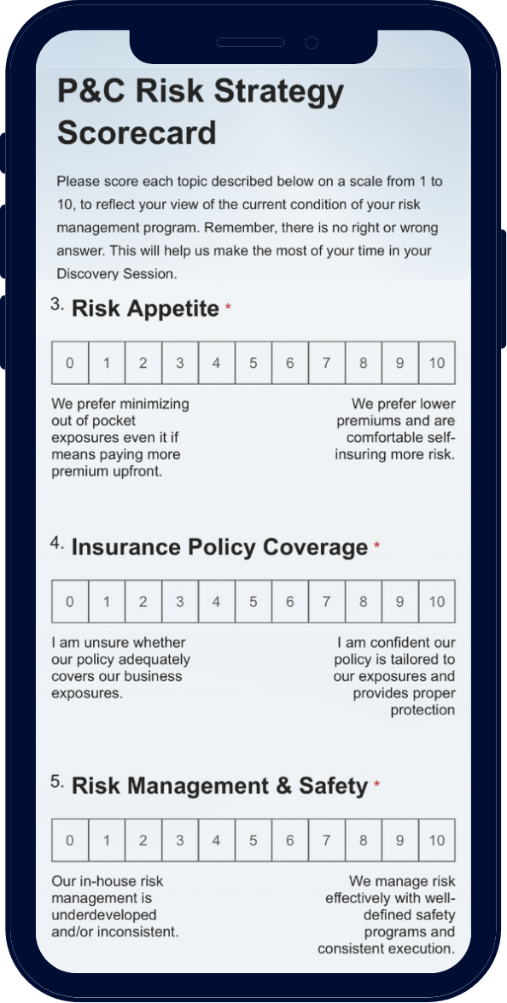
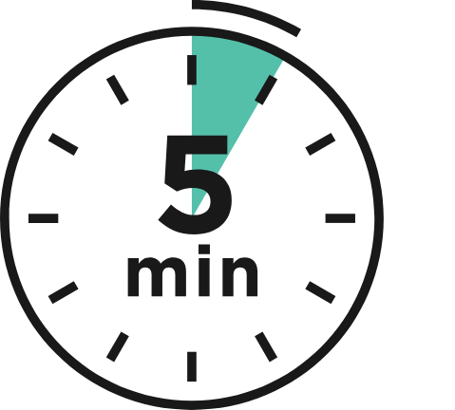
Discovery Part 1 | Scorecard
5 minutes of your time

Slide 9

Discovery Part 2 | Information Gathering
20 minutes of your time
Insurance policies, all lines
5-year claims history
Written safety programs: OSHA, DOT, Fleet, etc.
Risk transfer contracts
EE Handbook
Prior years marketing summary

Slide 10

Discovery Part 3 | Stakeholder Meeting
60 minutes of your time
Risk Appetite
Insurance Policy Coverage
Risk Management & Safety
Compliance Readiness
Risk Transfer Strategy
Claims Handling Process
Insurance Market Positioning
Service Requests & Renewal Process
Insurance Spend
Strategic Resources
Business Continuity

Slide 11
Assessment
Action Plan
Key Performance Indicators (KPIs)
Focus on specific steps and timeframes to achieve goals What do we need to do this year? How will we achieve this?
A measurable metric used to evaluate success of progress How will I know we are moving towards the goal? What are we defining as success, how do we measure it?
Big Picture. Defines overarching goals What do we want to achieve? Why is this important?
Strategic Plan
0 minutes of your time
Alera Group team completes full assessment
Create a true strategic plan based on the big picture goal, measurable KPI’s, and action plan
“What gets measured, gets done.”
Proprietary and confidential. All rights reserved.
10
Notes:
You can use this slide to highlight any Communication / Engagement initiatives that the client has in place, or that you think they should consider.
Employee Benefits - Employee Communication & Engagement (aleragroup.com)
Benefits Technology Alera Resources -
Employee Benefits - Benefits Technology & Administration (aleragroup.com)

Slide 12

Playbook Presentation
60 minutes of your time
Your value deliverable – 60 minutes
Market benchmarking & pricing analysis
Tailored coverage recommendations
Carrier strategy & renewal approach
Service commitment & support structure
      Dedicated account team
      Core service deliverables
      Proactive risk management strategy
      Claims advocacy & support
Forward looking action plans
      90-day implementation plan
      1-year strategic roadmap
Additional products

Slide 13
Proven Process. Real Results.
Carpentry & Construction
*Producers* - create your own social proof page… who have you helped and how?
Mad City Remodeling
Ace of All Trades, LLC
Mad City Windows
Olson Construction Inc.
River Valley Remodelers
  Premium Savings
  Lowering Experience Modifications
  Risk Management
  Claims Advocacy
  Renewal Process
  Core Services
  Carrier Resources
  Markets
  Other?

Slide 14

Any Questions?

